Slide 1

Chapter 9 sections 9.1-9.3: Memory Management
Notes:
This is a summarized presentation on Memory Management from sections 9.1 thru 9.3 of the text.
If you want more details, please refer to the powerpoint named Chapter 9-Details.
All of the information that you will need for the quiz or for the final will be contained in this powerpoint or Sections 9.1 thru 9.3
There is a lot of good information in Chapter 9 on error detection and raid storage systems that we do not have time to cover.
I encourage you to read the whole chapter.

Slide 2
Storage Management
OS manages resources
CPU time
Main Memory (RAM)
Secondary storage (Disk, etc.)
CPU time: Chapter 8
Main Memory and Secondary Storage: Chapter 9
Notes:
The Operating System’s job is to manage resources such as the CPU time, the Main Memory, and Secondary storage.
Chapter 8 discusses the CPU time allocation
In this section, we will discuss the main memory and secondary storage management.

Slide 3
Memory Management
Memory allocation
Program resides on disk
Must be allocated RAM space by OS
Must be allocated CPU time by OS
Notes:
Programs reside on the disk, when they need to run the OS must allocate RAM space and CPU time.

Slide 4
Memory Management
Main Memory allocation techniques:
Uniprogramming
Fixed-partition multiprogramming
Variable-partition multiprogramming
Paging
Virtual memory
Segmentation
Covered in OS course
Notes:
Here are the Main Memory allocation techniques that will be reviewed:
Uniprogramming
Fixed-partition multiprogramming
Variable-partition multiprogramming
Paging
Virtual memory
Segmentation.
Not covered here, but you’ll see it in your OS course.

Slide 5
Memory Management
Uniprogramming
System executes one job at a time
Used in Pep/8
OS resides at one end of memory,
application at other
Every job loaded at same place
Example: Pep/8 loads every app at 0000
If program contains a burn directive, assembler assumes that the last byte will be loaded at the address at bottom of memory
Notes:
With Uniprogramming, the system only executes one job at a time.
It is the technique used in Pep/8.
The OS resides at one end of memory, and the application at other.
Every job is loaded at same place
For example: Pep/8 loads every app at 0000
If program contains a burn directive, assembler assumes that the last byte will be loaded at the address at bottom of memory and that it replaces the operating system.

Slide 6
Memory Management
Uniprogramming
Advantages:
System is small and simple to design
Easier to make system bug-free
Little overhead
App gets 100% of processor’s time
Disadvantages
Inefficient use of CPU time
Inflexible job scheduling
Example: everyone must wait while a program does disk I/O
Cannot multi-program two jobs
Notes:
Uniprogramming has the Advantages of being small and simple to design
It is easier to make system bug-free and has little overhead and the App gets 100% of processor’s time
The Disadvantages are it has inefficient use of CPU time and inflexible job scheduling.
For example: everyone must wait while a program does disk I/O
It cannot multi-program two jobs

Slide 7
Memory Management
Fixed-partition multiprogramming
OS partitions MM into different regions
Storing different processes while they execute
Fixed-partition
OS subdivides memory into several regions
Regions sizes and locations do not change
OS occupies region at bottom of memory
Partitions are different sizes for different jobs
Notes:
With fixed-partition multiprogramming, the OS partitions main memory into different regions for storing different processes while they execute.
The OS subdivides memory into several regions whose sizes and locations do not change with time.
The OS occupies a region at the bottom of memory.
Partitions are different sizes for different jobs.

Slide 8
Fixed-Partition
Problem:
Memory references in object code must be adjusted for the region that they are loaded into.
Example: program loaded into a Region
OS loads it into a region staring at 8000(hex)
Object code was assembled starting at address 0000
All memory references are wrong
Notes:
One hurdle with fixed partition, is that the memory references in the object code must be adjusted for the region they are loaded into.
For example, when our PEP 8 programs were loaded the assembler assigned all the addresses for the code starting at 0000.
If the program was going to be loaded into a region that starts at address 8000 hex, then all the addresses are incorrect.

Slide 9
Fixed Partition - Address Problem
Solution:
Logical Addresses
Programmer/compiler generates code that starts at address 0000
Called a Logical Address
OS will translate the logical address to a physical address
Notes:
The solution is that the compiler will generate the object code starting at address 0000. This is called the logical address.
Then the OS will translate the logical address to a physical address depending on where in memory it is loaded.

Slide 10
Fixed Partition
Problem: internal fragmentation
Example: 10 KB program loaded into a 32KB Region
Need 10K, allocated 32K
22K is Wasted
Notes:
A problem with fixed partitioning is that there is internal fragmentation.
For example if a 10KB program is loaded into a 32KB region
There is 22K that is allocated but not used. It is wasted memory space.

Slide 11
Variable-Partition Multiprogramming
Variable-Partition Multiprogramming
Solution to internal fragmentation
OS maintains partitions with variable boundaries
Establish partition when job is loaded into memory
Size of partition exactly matches size of job
No internal fragmentation
Notes:
Variable partitioning solve the problem of internal fragmentation.
The OS establishes the partition when a job is loaded into memory and the size of the partition is adjusted to exactly match the size of the job.

Slide 12
Variable-Partition Multiprogramming
Holes
Job stops execution
That region of memory becomes available
Called a hole
OS allocates holes to subsequent jobs
OS tries to maintain as many jobs in memory as possible
Problem: external fragmentation
Notes:
When the job stops execution, the region that becomes available is called a hole. The OS will allocate holes to subsequent jobs, however they will need to be the same size or smaller to fit in the hole. This causes external fragmentation.

Slide 13
Compaction
Compaction
Solution to external fragmentation
Shift processes up
Strategy 1: Move all processes.
Strategy 2: Find process that can fill a hole.
Move only enough processes to create a hole big enough to satisfy the request
Notes:
Compaction is the solution to external fragmentation. The OS must employ a strategy to move the processes around to best utilize the holes.

Slide 14
Paging
Goal: avoid internal and external fragmentation
Method:
Break up program to fit memory
Notes:
Another technique used is paging. It avoids both internal and external fragmentation. Instead of compacting memory to fit the program, the program is broken up to fit memory.

Slide 15
Paging
Divide MM into frames of fixed size.
Divide every program into pages of fixed size.
Frame size MUST equal page size
Allocate enough frames to program so that all of its pages will have a frame
Program still assumes logical addressing
OS converts logical addresses to physical addresses during execution
Notes:
First, Divide main memory into frames of a fixed size. Then, divide every program into pages of a fixed size.
The frame size MUST equal page size. Next, allocate enough frames to the program so that all of its pages will have a frame.
Program still assumes logical addressing and the OS converts logical addresses to physical addresses during execution.

Slide 16
Paging
Hardware
partition system needs one base register
Paging needs a set of frame numbers, one for each page
Called a page table
Notes:
More Hardware is needed to manage a paging system.
With the partitioning systems one base register was sufficient to transform the logical address to a physical address.
A Paging system will need a set of frame numbers, one for each page of the job.
This is called a page table.

Slide 17
Paging Problems
Internal fragmentation
Last page may not need entire frame
Page size
smaller the page size = less fragmentation
smaller the page size =
greater the number of frames
larger the page table
Page tables use fast memory = expensive Want small page tables
Notes:
Paging still has its problems. There is still some internal fragmentation because the last page may not need an entire frame.
So the page size can be made smaller then there is less fragmentation.
But the smaller the page size, the greater the number of frames for a given MM size and the larger the page table
Page tables use fast memory, so they are expensive so the page tables need to be kept small.

Slide 18
Virtual Memory
Large Program Behavior
Most programs have dozens of procedures
Many never called
Some initialization routines only called once
Many loops
Some declarations never used
e.g., an array is declared to be size 1000, but only 1st 10 elements used
Notes:
Let’s move on to Virtual Memory.
Most programs have dozens of procedures and many are never called.
Some initialization routines are only called once and some have many loops.
Also some variable declarations never used. For example, an array is declared to be size 1000, but only 1st 10 elements used.

Slide 19
Virtual Memory
Large Program Behavior
Result: only part of a program needs to be in memory at a time
Working set: set of active pages
As program progresses
new pages enter the working set
old pages leave the working set
Notes:
The result is that only part of a program needs to be in memory at any one time.
Set of active pages is called the working set.
As the program progresses, new pages enter the working set, old pages leave.

Slide 20
Virtual Memory
Programmer illusion:
program executes in contiguous memory
logical addresses begin at zero
Reality:
System loads only a few pages at a time
Pages are dispersed throughout memory
Notes:
When a program executes the illusion to the Programmer is that it executes in contiguous memory with logical addresses beginning at zero.
In reality, the system loads only a few pages at a time and disperses these throughout memory

Slide 21
Virtual Memory
Demand Paging
System loads a page into MM
only when program demands it
Difference from paging
Paging loads all pages into MM
Notes:
With Demand Paging, the system loads a page into MM only when the program demands it. With regular paging, all the pages are loaded into memory.

Slide 22
Page Replacement
Problem: OS needs to read a page into memory - no frames available
Page Fault
OS selects a page that is in memory to replace
Page taken out of memory
Has changed - write page to disk
No changes – do not write to disk
Notes:
Now we move on to Page replacement strategy.
What if OS needs to read a page into memory and there are no frames available?
This is called a page fault
The OS must select a page that is in memory and replace it.
First, it needs to determine if the page has changed. If it has, it needs to be written to disk. If it has not changed, it does not need to write to disk.

Slide 23
Page Replacement
Dirty Bit
Frame table has a dirty bit
When page is loaded into memory
dirty bit set to 0
If store instruction is executed
dirty bit is changed to 1
When page is selected for replacement
OS looks at dirty bit
If Dirty bit = 1, write to disk
If Dirty bit = 0, do not write
Notes:
This is done with a Dirty Bit.
To help decide whether write is necessary, frame table has a special bit, the dirty bit.
When page is loaded into memory the dirty bit is set to 0
If store instruction is executed the dirty bit is changed to 1
When a page is selected for replacement, the OS looks at dirty bit
If the Dirty bit = 1, write the page to disk
If the Dirty bit = 0, no write is needed.

Slide 24
Page Replacement
Page-Replacement Algorithms
OS has two memory management tasks in a demand paged system:
Allocate frames to processes
Select a page for replacement when a page fault occurs and all frames are full
Notes:
The OS has two memory management tasks in a demand paged system:
To Allocate frames to the processes and to Select a page for replacement when a page fault occurs and all frames are full.

Slide 25
Page Replacement
Frame Allocation Strategies:
Assume that a large process needs more frames than a small process
Allocate frames proportionally
Allocate frames dynamically
Keep track of the working set
Larger working set = more frames allocated
Notes:
Strategies:
Can assume that a large process will need more frames than a small process so that the frames are allocated proportionally.
Or can allocate frames dynamically by keeping track of the working set.
The larger the working set, the more frames allocated.

Slide 26
Page Replacement
Page Replacement Strategies
Process has fixed number of frames
How does OS decide which page to replace?
FIFO (first in, first out)
LRU (least recently used)
Notes:
Once the OS has determined the number of frames for a process, How does OS decide which page to replace?
We will discuss two strategies:
FIFO (first in, first out)
LRU (least recently used)

Slide 27
Page Replacement
FIFO: first-in, first-out
Replace the oldest frame
New code & data added
Older code & data replace
Notes:
With FIFO, when a page fault occurs the oldest frame is replaced with the new one that is needed.
This works, however the frame that was replaced may be needed frequently and will need to reloaded.

Slide 28
LRU
Least Recently Used
Replace page not referenced the longest
Idea: page referenced recently in the past more likely to be referenced in the near future
Order in page table changes as each page is referenced
When a page is referenced, it is placed on top
Page fault causes the bottom page to be removed
LRU generally produces fewer page faults than FIFO
Notes:
The algorithm for Least Recently Used tries to allow for that.
It replaces the page that has not been referenced the longest.
It is based on the Idea that a page referenced recently in the past is more likely to be referenced in the near future.
The order in the page table changes as each page is referenced.
When a page is referenced, it is placed on top
So the most recently referenced on the top and the longest ago referenced is on the bottom
When a page fault occurs, the bottom page is removed and the new page is put on the top.
LRU generally produces fewer page faults than FIFO.

Slide 29
Page replacement
Each OS has own unique page-replacement algorithm
Depends on hardware features available
Most are approximations of the LRU
Effective demand paging system
Page fault rate needs to be:
less than one fault per 100,000 memory references
Notes:
Each OS has its own unique page-replacement algorithm
Depends on hardware features available
Most page-replacement algorithms are approximations to the LRU.
For a demand paging system to be effective, the page fault rate needs to be kept to less than one fault per 100,000 memory references.

Slide 30
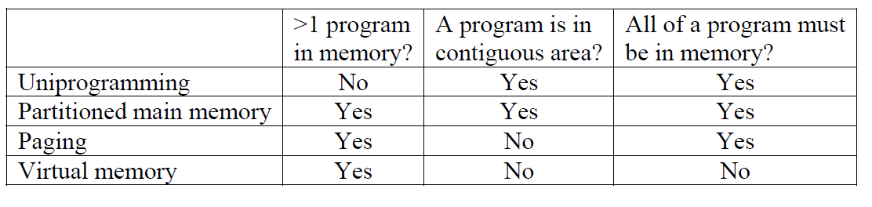
Summary of the 4 main memory models
Notes:
Here is a summary of the 4 main memory models that we have discussed.
I recommend that you look this over, it just might show up on the quiz.

Slide 31
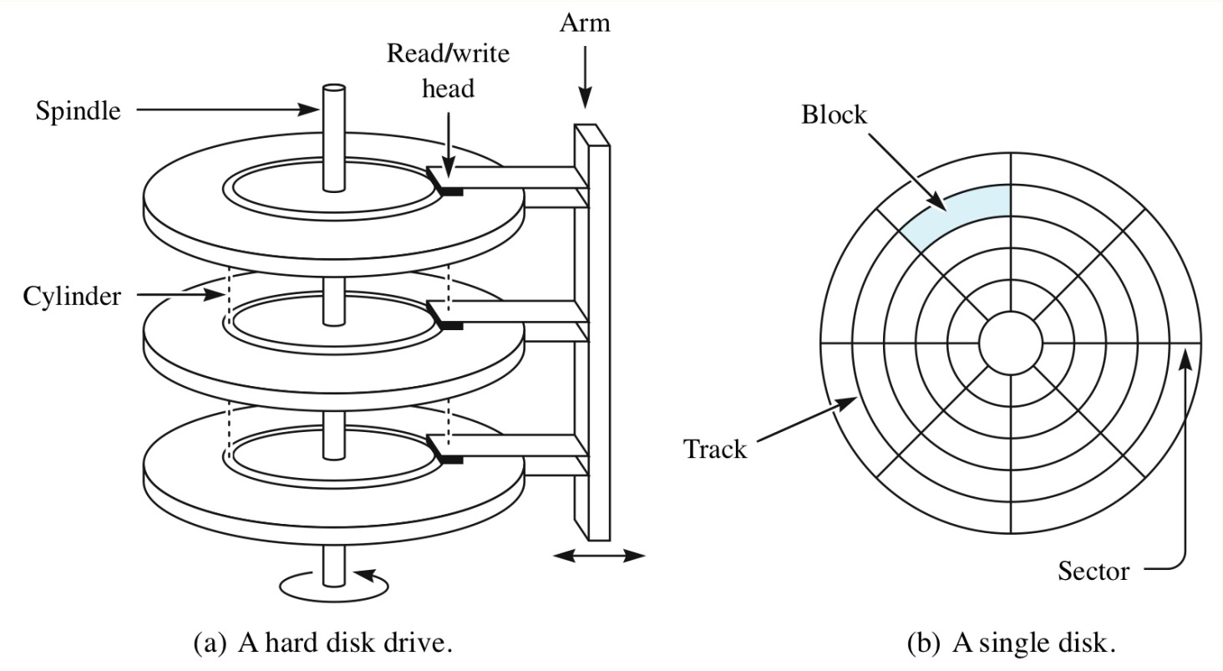
Storage of data on discs
Basic model of a disc
Set of parallel rotating platters
Read/write heads move as a unit into one of a finite number of positions
Notes:
Here is a basic model of a disc is a set of parallel rotating platters on which data can be recorded
Read/write heads move as a unit into one of a finite number of positions.

Slide 32
Disc addressing
Projection of the read/write head on recording surface defines a track
Track is divided into sectors
smallest addressable unit of the disc
Block address is a three-part object:
Surface-number, track-number, sector-number
Notes:
As the disc rotates, the projection of the read/write head on the recording surface defines a track on which data can be stored.
A track is normally divided into sectors and a sector is usually the smallest addressable unit of the disc.
Therefore a block address is a three-part object:
Surface-number, track-number, sector-number

Slide 33
Disc addressing
Set of tracks (one per surface) having the same radius is called a cylinder
Capacity of a disc is the product:
Recording_surfaces * tracks-per-surface * sectors-per-track * bytes-per-sector
Some bytes
used for formatting information (e.g., track numbers)
not available for users
Notes:
The set of tracks (one per surface) having the same radius is called a cylinder (because of its shape)
The capacity of a disc is nominally the product:
Recording_surfaces * tracks-per-surface * sectors-per-track * bytes-per-sector
Some bytes might be used for formatting information (e.g., track numbers) and not available for users.

Slide 34
Disc Access
Read/write a sector:
move the read/write heads to the appropriate track
wait for sector to rotate around
latency time is, on average, half a rotation
Faster spinning discs, e.g. 15,000 rpm vs 3600 rpm reduces latency
do read/write
Operating System
allocate space in clusters of sectors (e.g. an allocation unit might be 4 sectors)
reduce overheads
allocate data cylinder by cylinder rather than surface by surface
Notes:
To read/write a sector, we need to:
move the read/write heads to the appropriate track
wait for the sector to rotate around. The latency time is, on average, half a rotation.
Faster spinning discs, e.g. 15,000 rpm vs 3600 rpm reduces latency.
Then do the read/write
An Operating System will typically allocate space in clusters of sectors (e.g. an allocation unit might be 4 sectors) to reduce overheads. It is also likely to allocate data cylinder by cylinder rather than surface by surface.

Slide 35
Contributions to the disk access time
Seek time
Time for the head to reach the cylinder
Latency
Time for start of sector to rotate to head
Transmission time
Time for sector to pass under head
Notes:
So the contributions to disk access time are:
The seek time, which is the time for the head(s) to get in position over the cylinder.
The latency time, which is the time for the beginning of the sector to arrive under the head.
And the transmission time, which is the time for the entire sector to pass under the head to be read or written.
Thank you for listening, please review presentation on Chapters 8 and 12 before taking the quiz.

